Slide 1
Question 4: Portfolio Commentary
Liam Andrew Beattie - 22562435

Slide 2
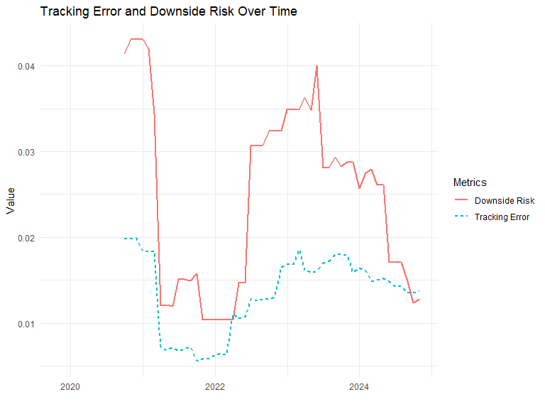
Relative Risk

Slide 3
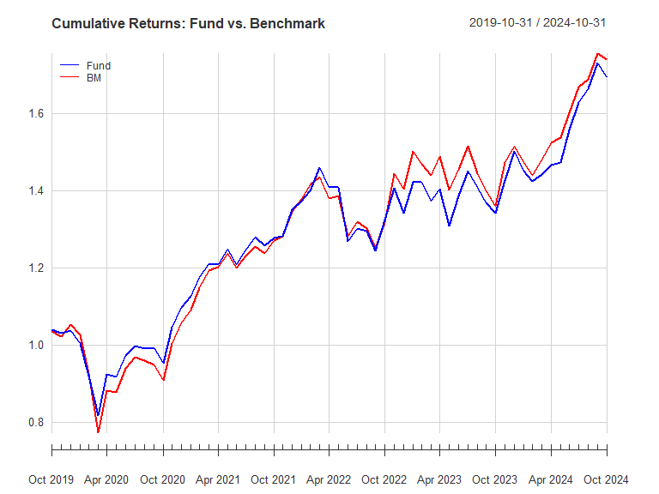
Relative Performance

Slide 4
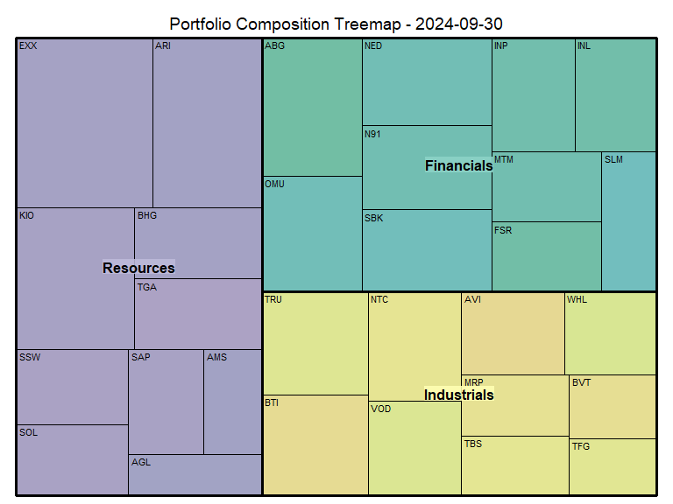
Fund Positioning

Slide 5
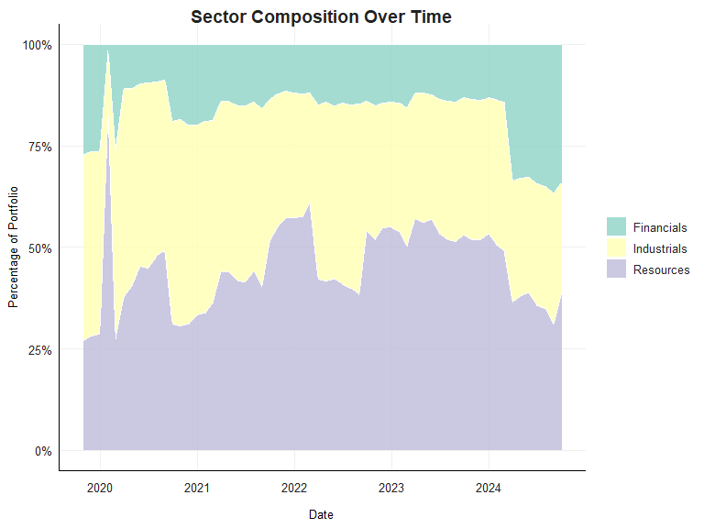
Resources holdings spike at the begining of 2020

Slide 6
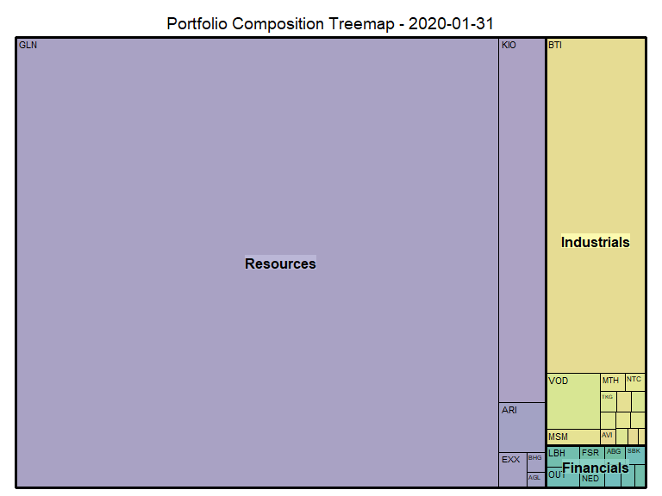
We see that at the beginning of 2020 the Portfolio was dominated by Glencore PLC

